Slide 1
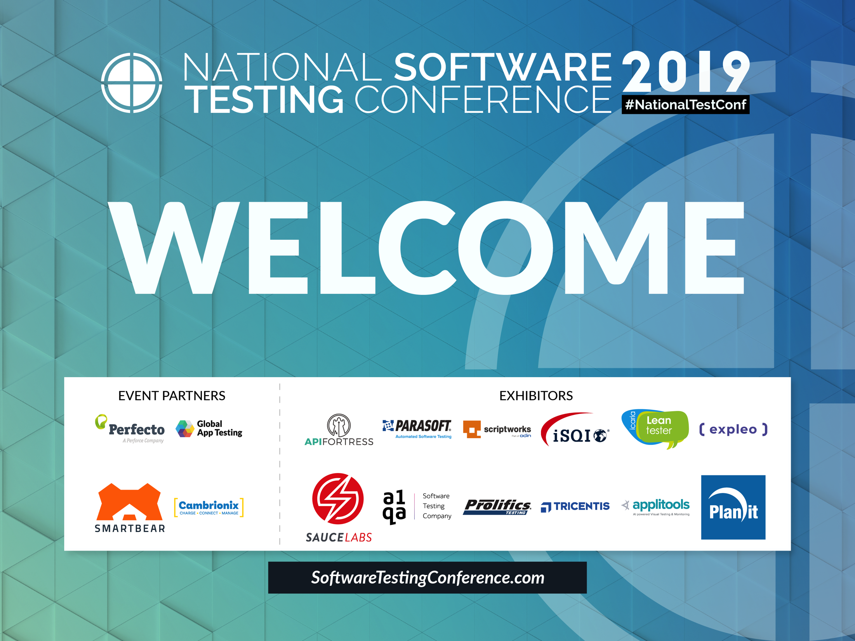

Slide 2
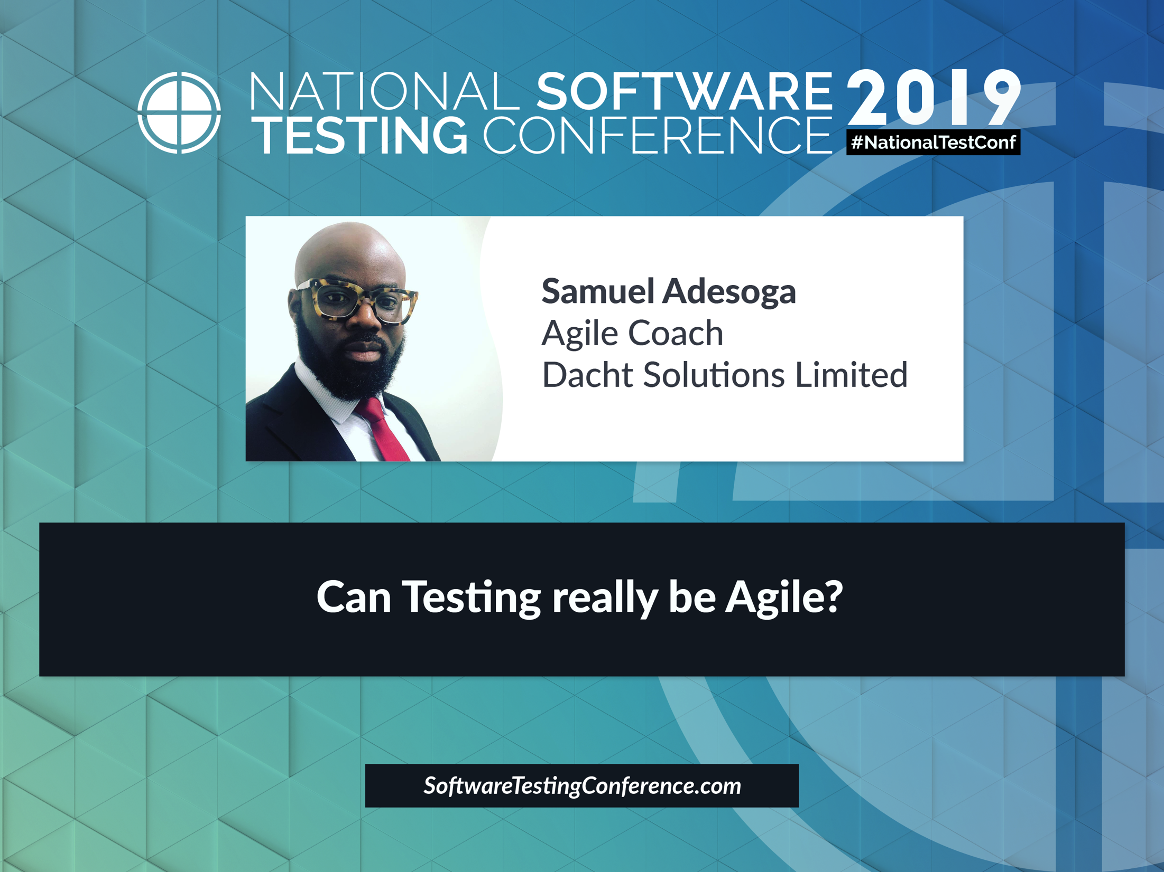

Slide 3
Can Testing really be Agile?
Samuel Adesoga

Slide 4
Agile Score Board
Requirement Gathering & Analysis ✔
Development ✔
Testing ✖

Slide 5
“Individual and Interactions” over “Processes and Tools”
“Working Software” over “Comprehensive Documentation”
“Customer Collaboration” over “Contract Negotiation”
“Responding to a Change” over “Following a Plan”

Slide 6
“Individual and Interactions”
over
“Processes and Tools”

Slide 7
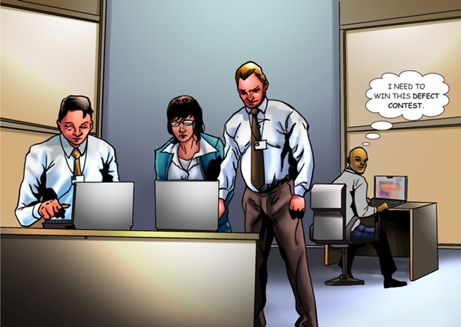

Slide 8
Practices:
User stories Huddles.
Testers in architectural designs decisions sessions.
Discuss defects not hand over Tickets (Jira)
Collaborate on high-level acceptance criteria

Slide 9
Benefits
Reduce Test Duplication across layers within the Test Pyramid
Testing is pushed to the left as far as possible.
Higher chance of representing business expectations.
Increase confidence of the business in the product being built.
A culture of the co-ownership of code and tests is a by-product of these sorts of working practices.

Slide 10
“Working Software”
over
“Comprehensive Documentation”

Slide 11
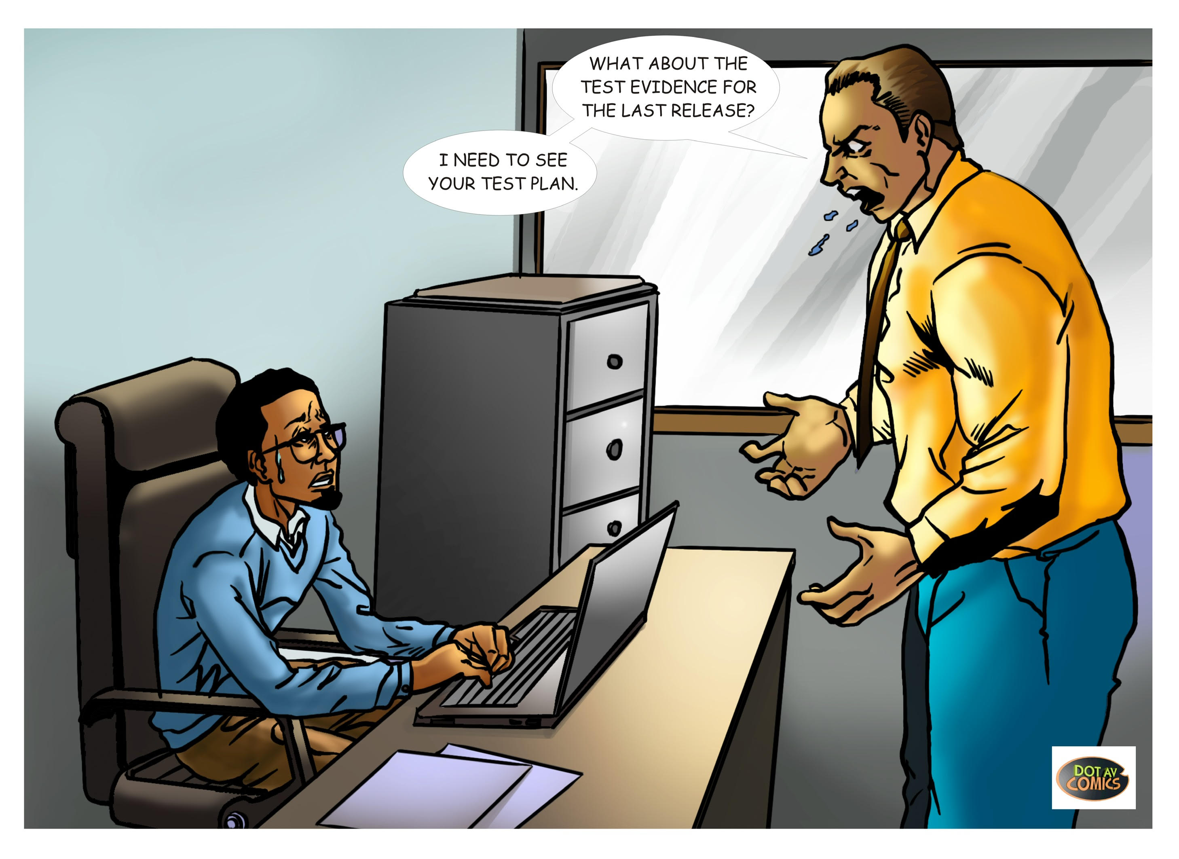

Slide 12
Practices
Publish a Test Approach document
Tests as living documentation.
Automate Test Reports
Performance tests as part of the pipeline.

Slide 13
Benefits
Time made available for higher value activities e.g. Exploratory Tests
Test and Quality is visible to all and Trust is established

Slide 14
“Customer Collaboration”
over
“Contract Negotiation”

Slide 15
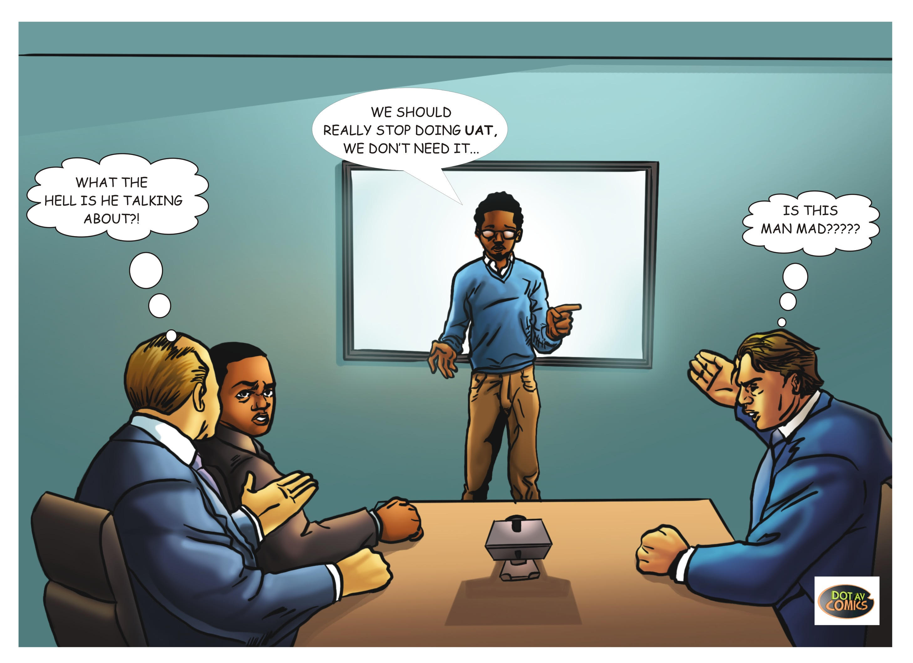

Slide 16
Practices
Tests should reflect expected customer behaviour.
Chosen Test framework should be expressive (DSL Test Framework).
Test report is fluent and readable
Make Tests reports should be visible

Slide 17
Benefits
User Acceptance Testing phase can be removed. (UAT)
Business users’ time is being used effectively, upfront and continuously.

Slide 18
“Responding to a Change”
over
“Following a Plan”

Slide 19
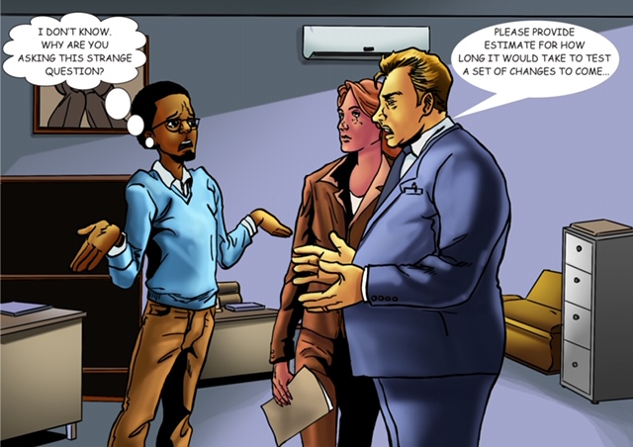

Slide 20
Practices
Everyone regards tests as an integral part of the product.
Definition of DONE should include all tests.
Everyone needs to seek and exploit opportunities to tests at the level with minimal cost.
Test effort should not be estimated separately from the development efforts.
As much as possible tests should be automated

Slide 21
Benefits
As tests are integrated into the deliverable, there isn’t any extra effort to test changes apart from the actual effort to make the change.

Slide 22
Lets go home …
Quality Checks (Tests) are embedded in User Stories, Unit Tests and Acceptance Tests.
Create opportunities for conversations that potential leads to removing the UAT Phase.
A story not tested is not “DONE”.
Write fluent tests and make test report visible.

Slide 23
